Slide 1

LAMI Full-Stack Application
LAMI Team: Jacob Smith and Jerrel Chapman

Slide 2


Project Overview and Requirements
Spend one minute describing the company/client’s needs
The Goal of this project is to create an application that sets reminders for resident of the LAMI household that tell them when to take medications.
Allow the caretakers a view that can see all clients medications
Add something to allow for motivation to use the app(Duolingo)
Switch to single factor authentication(PIN)

Slide 3

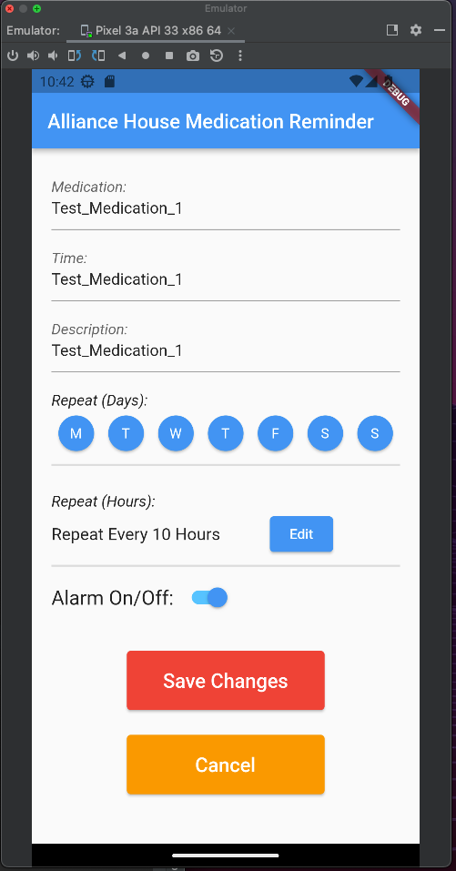
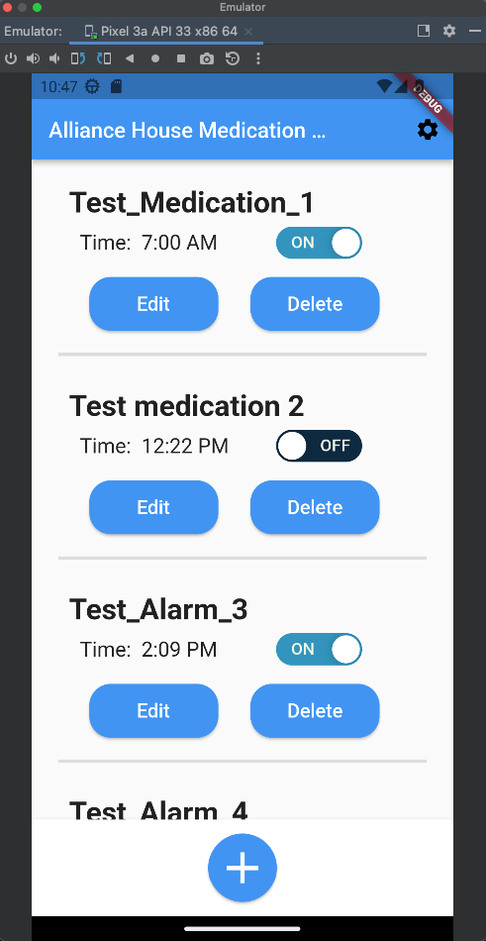
Project Solution Approach
Major components
Flutter(web/mobile app)
Android studio
UI Design and Layout

Slide 4
Project’s Current Status
Resident page
Separated the edit and delete button
Added a more diverse pool of times to choose from when choosing an alarm
Added the feature to turn on and off alarms
Added a new more intuitive add alarm button at the bottom of the screen
Added a repeat day feature

Slide 5
Project’s Future Work
Adding a notification sound
Making the single factor authentication PIN
Adding a motivation factor for the app(Duolingo)
Allowing the caretaker to see the residents' medications
Change the login request time to later so that the password doesn’t need to be put in very much
Fix the horizontal change when flipping a phone

